Slide 1






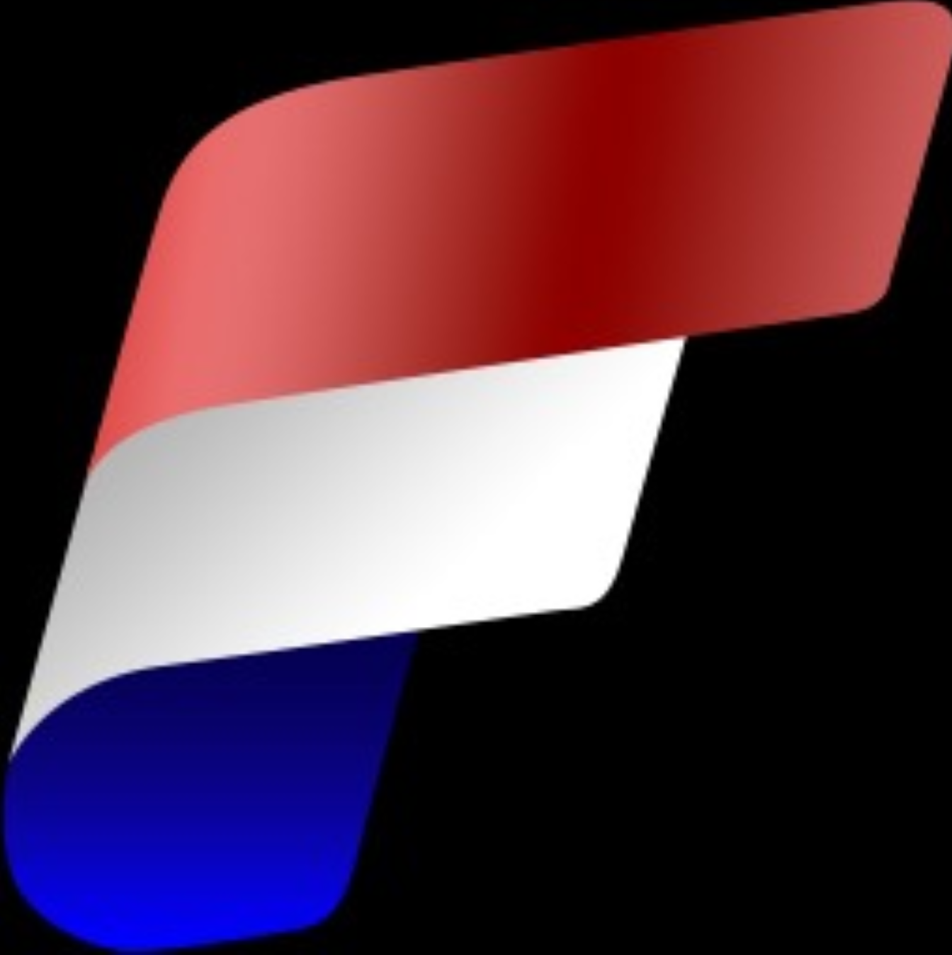


Let’s connect
Erwin de Kreuk
Principal Consultant
Lead Data & AI InSpark
@erwindekreuk.bsky.social linkedin.com/in/erwindekreuk
erwindekreuk.com
github.com/edkreuk
https://sessionize.com/erwin-de-kreuk/
Dutchfabricusergroup.com
Notes:
We help organizations accelerating their digital transformation with impactful Microsoft solutions & expertise

Slide 2






Onelake with Fabric, The Data Lake-as-a-Service Platform

Slide 3






THANK YOU, SPONSORS!!!!
Platinum
Gold
Silver
Bronze

Slide 4
A world awash with data…

Slide 5

AI is transforming the world
Data is the fuel that powers AI

Slide 6
Good AI, needs clean data

Slide 7

How do you translate data into
competitive advantage?
Notes:
Menu for core section on this slide

Slide 8
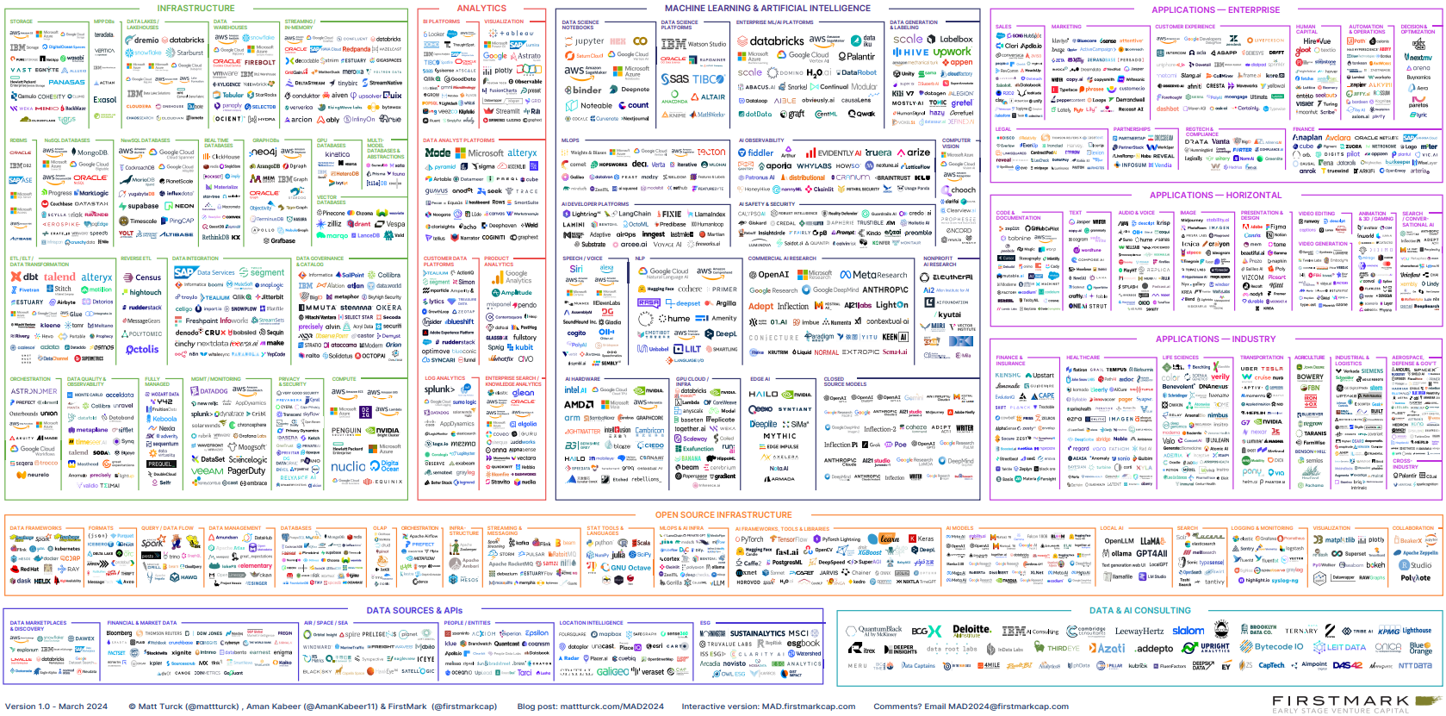
The 2024 data and AI landscape
Notes:
In this image by FirstMark covering the data and AI landscape has 2011 logos across different categories. To help you tackle this mess

Slide 9
“
Unify, I am the Chief Information Officer and don’t want to be the Chief Integration Officer.
Help me unleash AI in my data estate.”
Every CIO, Every Enterprise

Slide 10

Objectives of today
Onelake
Shortcuts
Mirroring
Catalog
Security
Recap

Slide 11
Growing importance of Data in the era of AI

Slide 12
Data is the oxygen of digital transformation
Employee Experiences
Signal
Action
Data is the oxygen of digital transformation
Intelligent Applications
Customer Experience
Data
Action
Signal
Signal
Products
Action
“A new kind of company — we call them insights driven businesses — has formed. They are growing at an average of more than 30% annually”
Forrester Analytics Business Technographics Global Data & Analytics Survey
Operations
Signal
Action

Slide 13
Today’s data value creation challenges
Siloed systems and data
Fragmented toolset, Platforms requiring advanced skills
Costly integration and ongoing maintenance
Proprietary Platform, Vendor Lock in
Infrastructure not scalable as business grows
Gaining BI adoption to streamline data sharing, collaboration
Data and security risks, Governance & Compliance

Slide 14

Starting line: Multiple siloed lakes with lots of duplication
IT
Sales
Operations
Marketing
Data movement
Data movement
Data movement
Data movement
Data movement
Data movement
Data movement
Data movement

Slide 15

How many are using Microsoft Fabric?

Slide 16





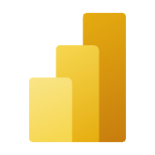



Microsoft Fabric
The unified data platform for AI transformation
Data
Factory
Analytics
Real-Time Intelligence
Power BI
Databases
Fabric Platform
AI
OneLake
Governance
Notes:
To help you tackle this mess, a year and a half ago Microsoft introduced Microsoft Fabric, our end-to-end data platform for the era of AI transformation, with data integration, analytics, databases, BI and AI all in one place, with data stored in open format in Fabric OneLake, platform that keeps evolving with new addition of SQL DB, industry specific solutions like healthcare and partner workloads. Fabric also comes with built-in capabilities to governance and security to help you effectively manage and govern your data, including built-in, industry-leading network and data security along with tools to help you manage federated data governance and native integration with Microsoft Purview.

Slide 17
Microsoft Fabric
The unified data platform for AI transformation
AI-powered data platform
Open and AI-ready data lake
AI-enabled business users
Complete data platform
OneLake
For every business user
Unified, SaaS-ified
Multi-cloud
Built into Microsoft 365
Secured and governed
Open at every tier
M365 Copilot Integrated

Slide 18









Bringing your data to Fabric
Power Apps
Dynamics 365 Sales
Dynamics 365 Customer Service
Dynamics 365 Field Service
Dataverse
Microsoft Fabric
Microsoft OneLake
Dynamics 365 Marketing
Dynamics 365 Finance & Supply chain

Slide 19








The value in your ERP data
Access Control
Human Resources
ERP Software
Data Services
Customer Relationship
Purchase Planning
Supply Chain
Project Management
Engineering

Slide 20
Why OneLake? I already have <insert storage service here> !
With OneLake…
No more migration or adoption of new, centralized processes for storing and consuming data.
Build on the data you already access need and are empowered to use your preferred technologies.
Use one unified, logical lake that meets you where you are.

Slide 21

















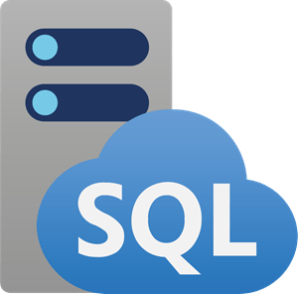
OneLake data is available everywhere
Data Platforms
Productivity
Microsoft
Fabric
AI and ML
M365
Copilot
Microsoft
Excel
Microsoft
Teams
Power
Platform
Azure Databricks
Snowflake
Azure
ML
Copilot Studio
Azure AI
Foundry
VS
Code
OneLake
Multi-cloud shortcuts
Database
Mirroring
Azure
AWS S3
GCP
Dataverse
Snowflake
On-Prem
Cross Tenant
Databricks
SQLDB
COSMOS DB
SQL MI

Slide 22
OneLake: A fully managed SaaS data lake Distributed ownership and isolation boundary with workspaces
Provisioned automatically with the tenant.
All data is ultimately under the control of a tenant admin, making it easy to adhere to standardized policies and governance.
OneLake can scale to the needs of any organization by enabling distributed ownership via workspaces.
OneLake
Workspace
Workspace
Workspace
Workspace
Workspace
Unified Security and Governance

Slide 23
OneLake which logically spans the world
No infrastructure to manage
OneLake
When you store data in OneLake, the underlying physical storage is virtualized away.
Workspace
POS sales
Workspace online sales
Workspace
customer
Workspace
ads
Workspace
expenses
Data can reside in different regions without managing different storage resources.
Meet demand for any scale with dedicated storage resources for each workspace (capacity, throughput and IOPS).
All storage is zone redundant by default with an option for Geo redundancy.
1+ Million
15 Weeks
Azure storage accounts under management
Doubling rate of storage volume

Slide 24
Everyone can work together in OneLake Distributed ownership and isolation boundary with workspaces
Within an organization:
Some teams will be pro-developers that might use multiple workspaces and consume a lot of compute.
Other teams might primarily blend data in a workspace for downstream consumption.
OneLake
Workspace
POS sales
Workspace online sales
Workspace
customer
Workspace
ads
Workspace
expenses
Sales
Marketing
Finance
Unified Security and Governance

Slide 25


OneLake is the OneDrive for data
Single SaaS lake for the whole organization
Data
Factory
Analytics
Databases
Real-Time Intelligence
Power BI
Single open format used by all workloads to store and query data
Automatically indexed for discovery, MIP labels, lineage, PII scans, sharing, governance and compliance
OneLake

Slide 26
OneLake is the OneDrive for data
Once data is stored in the lake, it is directly accessible by all the engines without needing any import/export
Data
Factory
Analytics
Databases
Real-Time Intelligence
Power BI
All compute engines are optimized for Delta Parquet as their native format.
Serverless
Compute
Spark
T-SQL
KQL
Analysis Services
Underlying physical storage is virtualized away. OneLake ensures proper scale and performance
Sales
Finance
Service Telemetry
Business KPIs
OneLake
Delta – Parquet Format
Delta – Parquet Format
Delta – Parquet Format
Delta – Parquet Format

Slide 27
Bringing data together with Shortcuts
No data movement or duplication
A shortcut is a symbolic link which points from one data location to another.
Create a shortcut to make data from a warehouse part of your lakehouse.
OneLake
Create a shortcut within Fabric to consolidate data across items or workspaces without changing the ownership of the data. Data can be reused multiple times without data duplication.
Workspace
POS sales
Workspace online sales
Workspace
customer
Workspace
ads
Sales
Marketing
Unified Security and Governance
Now different business team in the company can leverage data produced by domain owners or perhaps, centralized IT teams.

Slide 28
Bringing data together with Shortcuts
No data movement or duplication
Shortcut Location
OneLake
Files
RemoteData
LocalData1
LocalData2

Slide 29

Bringing data together with Shortcuts
No data movement or duplication
Shortcut Location
OneLake
Files
RemoteData
Transactions1.csv
Transactions2.csv
Transactions3.csv
LocalData1
LocalData2

Slide 30

Bringing data together with Shortcuts
No data movement or duplication
Shortcut Location
Shortcut Location
OneLake
ADLS Gen 2
Files
RemoteData
[..]
Transactions1.csv
Transactions1.csv
Transactions2.csv
Transactions2.csv
Transactions3.csv
Transactions3.csv
LocalData1
LocalData2

Slide 31

Unifying data in OneLake
Cross-cloud shortcuts & mirroring
First multi-cloud SaaS data lake
Data
Factory
Analytics
Databases
Real-Time Intelligence
Power BI
Shortcuts for existing data cross clouds and on-premises
OneLake
Shortcuts are instantaneous, with no data duplication or movement
Mirroring creates a reflection of an entire database in OneLake
Snowflake
Azure
AWS S3
GCP
Dataverse
Databricks
Snowflake
On-Prem

Slide 32
OneLake gives a true data mesh as a service
Group multiple workspaces into a single business domain and provide a governance boundary between the tenant admin and the workspace.
OneLake
Sales
Marketing
Avoid data swamps by endorsing certain data as certified or promoted, thus encouraging reuse.
Workspace
POS sales
Workspace online sales
Workspace
customer
Workspace
ads
OneLake Shortcuts provide the links between domains without data movement or duplication and without changing the ownership of the data.
Finance
Workspace
expenses
Unified Security and Governance

Slide 33
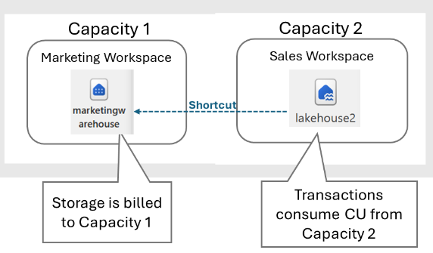
Building out a data mesh with capacities
OneLake transactions (e.g., reads and writes) consume Fabric capacity.
Consumers pay with cross-capacity shortcuts
For example:
The marketing team can a capacity that powers data transformations and meets production SLAs.
Sales can shortcut to this data from a different capacity and not affect the marketing capacity, it can even be paused!

Slide 34



Unifying data in OneLake
Cross-cloud shortcuts & mirroring
Sharing data in OneLake is as easy as sharing files in OneDrive, removing the needs for data duplication
Data
Factory
Analytics
Databases
Real-Time Intelligence
Power BI
With shortcuts, data throughout OneLake can be composed together without any data movement
OneLake
Capacity 1 – East US
Capacity 1 – East US
Workspace 1
Workspace 3
With support for industry standard APIs, OneLake data can be directly accessed by any application or service
Lakehouse
Warehouse
KQL Database
Lakehouse
Warehouse
KQL Database
Workspace 2
Workspace 3
Lakehouse
Lakehouse
Lakehouse
Lakehouse
Lakehouse
Lakehouse
Snowflake
Azure
AWS S3
GCP
Dataverse
Databricks
Snowflake
On-Prem
Unify data sources with OneLake shortcuts - Microsoft Fabric | Microsoft Learn

Slide 35
Unifying data in OneLake
Cross-cloud shortcuts & mirroring
Sharing data in OneLake is as easy as sharing files in OneDrive, removing the needs for data duplication
Data
Factory
Analytics
Databases
Real-Time Intelligence
Power BI
With shortcuts, data throughout OneLake can be composed together without any data movement
OneLake
Capacity 1 – East US
Capacity 2 – West US
Workspace 1
Workspace 3
With support for industry standard APIs, OneLake data can be directly accessed by any application or service
Lakehouse
Warehouse
KQL Database
Lakehouse
Warehouse
Lakehouse
Workspace 2
Lakehouse
Lakehouse
Lakehouse
Snowflake
Azure
AWS S3
GCP
Dataverse
Databricks
Snowflake
On-Prem
Unify data sources with OneLake shortcuts - Microsoft Fabric | Microsoft Learn

Slide 36
Unifying data in OneLake
Cross-cloud shortcuts & mirroring
Sharing data in OneLake is as easy as sharing files in OneDrive, removing the needs for data duplication
Data
Factory
Analytics
Databases
Real-Time Intelligence
Power BI
With shortcuts, data throughout OneLake can be composed together without any data movement
OneLake
Capacity 1 – East US
Capacity 2 – West US
Workspace 1
Workspace 3
With support for industry standard APIs, OneLake data can be directly accessed by any application or service
Lakehouse
Warehouse
KQL Database
Lakehouse
Warehouse
Lakehouse
Workspace 2
Lakehouse
Lakehouse
Lakehouse
Snowflake
Azure
AWS S3
GCP
Dataverse
Databricks
Snowflake
On-Prem
Unify data sources with OneLake shortcuts - Microsoft Fabric | Microsoft Learn

Slide 37
Unifying data in OneLake
Cross-cloud shortcuts & mirroring
Sharing data in OneLake is as easy as sharing files in OneDrive, removing the needs for data duplication
Data
Factory
Analytics
Databases
Real-Time Intelligence
Power BI
With shortcuts, data throughout OneLake can be composed together without any data movement
OneLake
Capacity 1 – East US
Capacity 2 – West US
Workspace 1
Workspace 3
With support for industry standard APIs, OneLake data can be directly accessed by any application or service
Lakehouse
Warehouse
KQL Database
Lakehouse
Warehouse
Lakehouse
Workspace 2
Lakehouse
Lakehouse
Lakehouse
Snowflake
Azure
AWS S3
GCP
Dataverse
Databricks
Snowflake
On-Prem
Unify data sources with OneLake shortcuts - Microsoft Fabric | Microsoft Learn

Slide 38
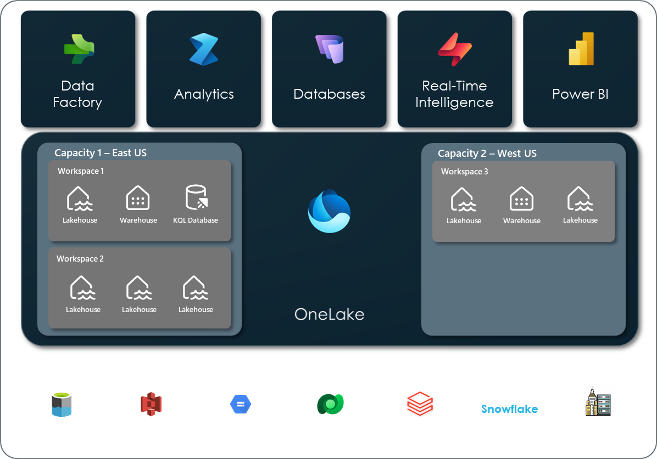
Unifying data in OneLake
External Data Sharing
Tenant Customer A Tenant Customer B
External Data Sharing in Microsoft Fabric - Microsoft Fabric | Microsoft Learn

Slide 39
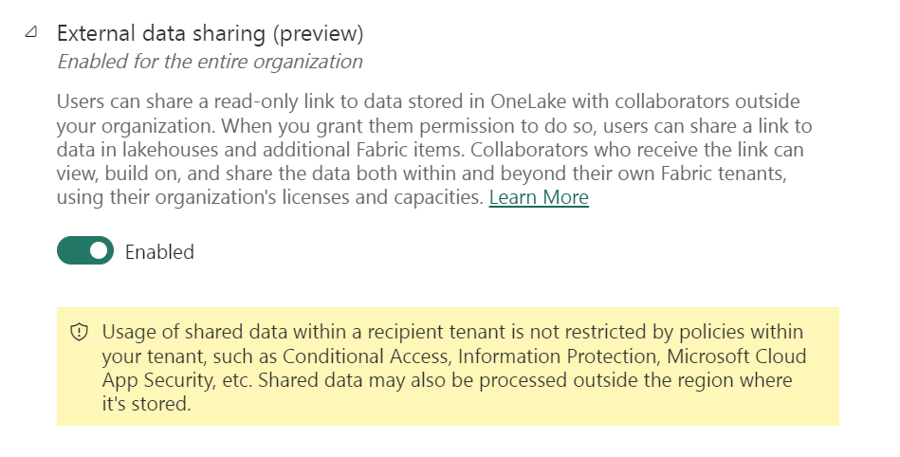
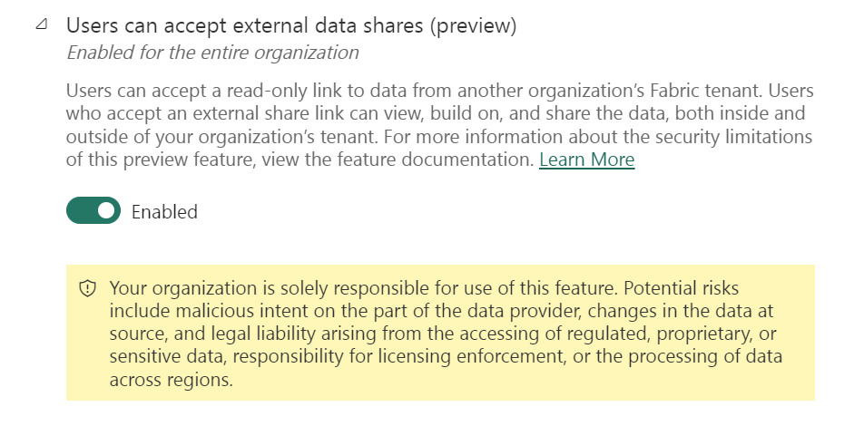
Unifying data in OneLake
External Data Sharing

Slide 40
Any questions so far?

Slide 41


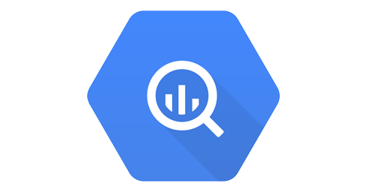
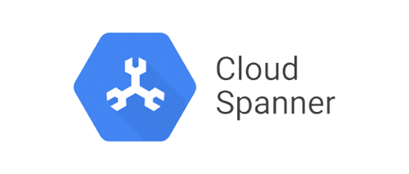

Unifying data in OneLake
Cross-cloud shortcuts & mirroring
Fabric Mirroring allows adding existing databases and data warehouses to Fabric without any ETL with a new item type Mirrored database
Data
Factory
Analytics
Databases
Real-Time Intelligence
Power BI
OneLake
Data is replicated into OneLake in Delta format and kept up-to-date in near-real-time via change data feed technology
Capacity 1 – East US
Capacity 2 – West US
Workspace 1
Workspace 3
Lakehouse
Warehouse
KQL Database
Lakehouse
Warehouse
Lakehouse
Open mirroring framework allows mirroring of virtually every database type
Workspace 2
Lakehouse
Lakehouse
Lakehouse
The replica protects operational databases from analytical queries
Storage for mirroring is free!
Azure
Amazon
Google
Mirroring - Microsoft Fabric | Microsoft Learn

Slide 42

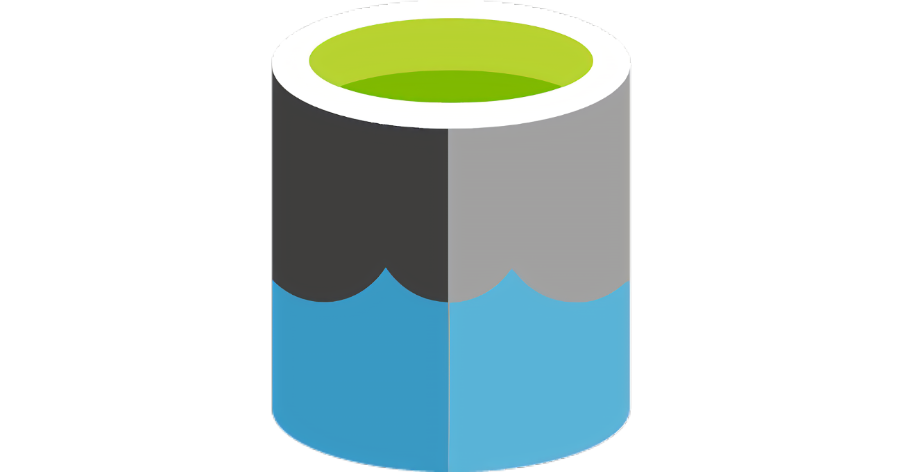





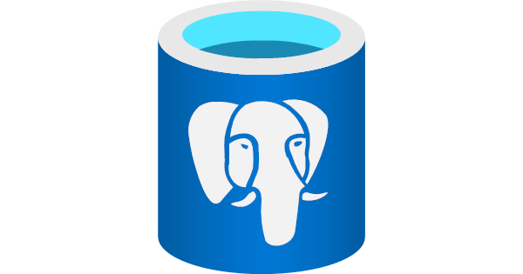

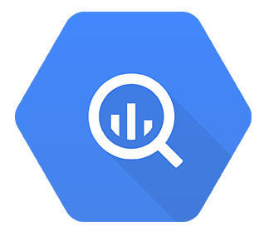



Unify data in OneLake with zero ETL
Shortcut & mirroring sources
Generally available
Public preview
Coming soon
Azure SQL DB
Azure Data Lake store
Microsoft OneLake
Azure Cosmos DB
Azure SQL MI
Oracle DB
Snowflake
Google Cloud Storage
Snowflake
Amazon S3
Azure PostgreSQL
Databricks Catalog
Google BigQuery
NEW!
NEW!
Microsoft Dataverse
S3 Compatible (cloud/On-prem)
SQL Server 2025
Azure Blob storage

Slide 43
OneLake data is available everywhere
Data Platforms
Productivity
Microsoft
Fabric
AI and ML
M365
Copilot
Microsoft
Excel
Microsoft
Teams
Power
Platform
Azure Databricks
Snowflake
Azure
ML
Copilot Studio
Azure AI
Foundry
VS
Code
OneLake
Multi-cloud shortcuts
Database
Mirroring
Azure
AWS S3
GCP
Dataverse
Snowflake
On-Prem
Cross Tenant
Databricks
SQLDB
COSMOS DB
SQL MI

Slide 44
Announcing Shortcut Transformations: from files to Delta tables. Always in sync, no pipelines required
Why use Shortcut transformations
Shortcut transformations help users:
Accelerate time-to-insight by skipping complex ETL pipelines.
Reduce operational overhead and data movement.
Enable self-service data transformation for business users.
Maintain governance with built-in monitoring and lineage tracking.

Slide 45
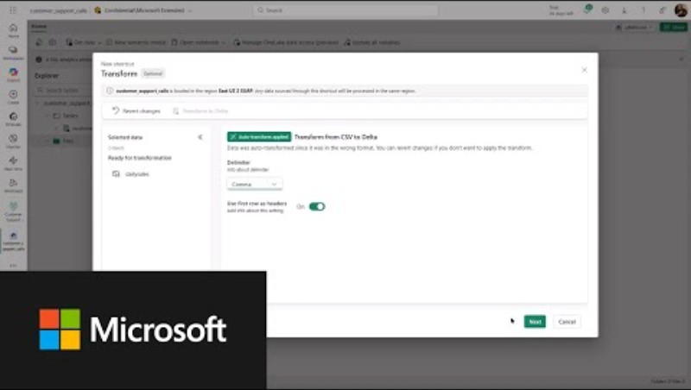
Announcing Shortcut Transformations: from files to Delta tables. Always in sync, no pipelines required

Slide 46

Notes:
Demo 2
Activeer capacity
Create a workspace identity in WS_DEMO
ededeuwdvlmdloxgn01 - Microsoft Azure
Close network
Set Resource Instance
Create shortcut
https://ededeuwdloxgn01.dfs.core.windows.net/
Paid capacity
Create Private endpoint
/subscriptions/e65d3c17-0581-403d-916c-b4f0733aacf1/resourceGroups/EDED-EUW-DEVELOPMENT-OXYGEN-RG/providers/Microsoft.KeyVault/vaults/ededeuwdvlmvaultoxgn01
Show admin Portal to close down Azure Private Link

Slide 47

OneLake Catalog

Slide 48
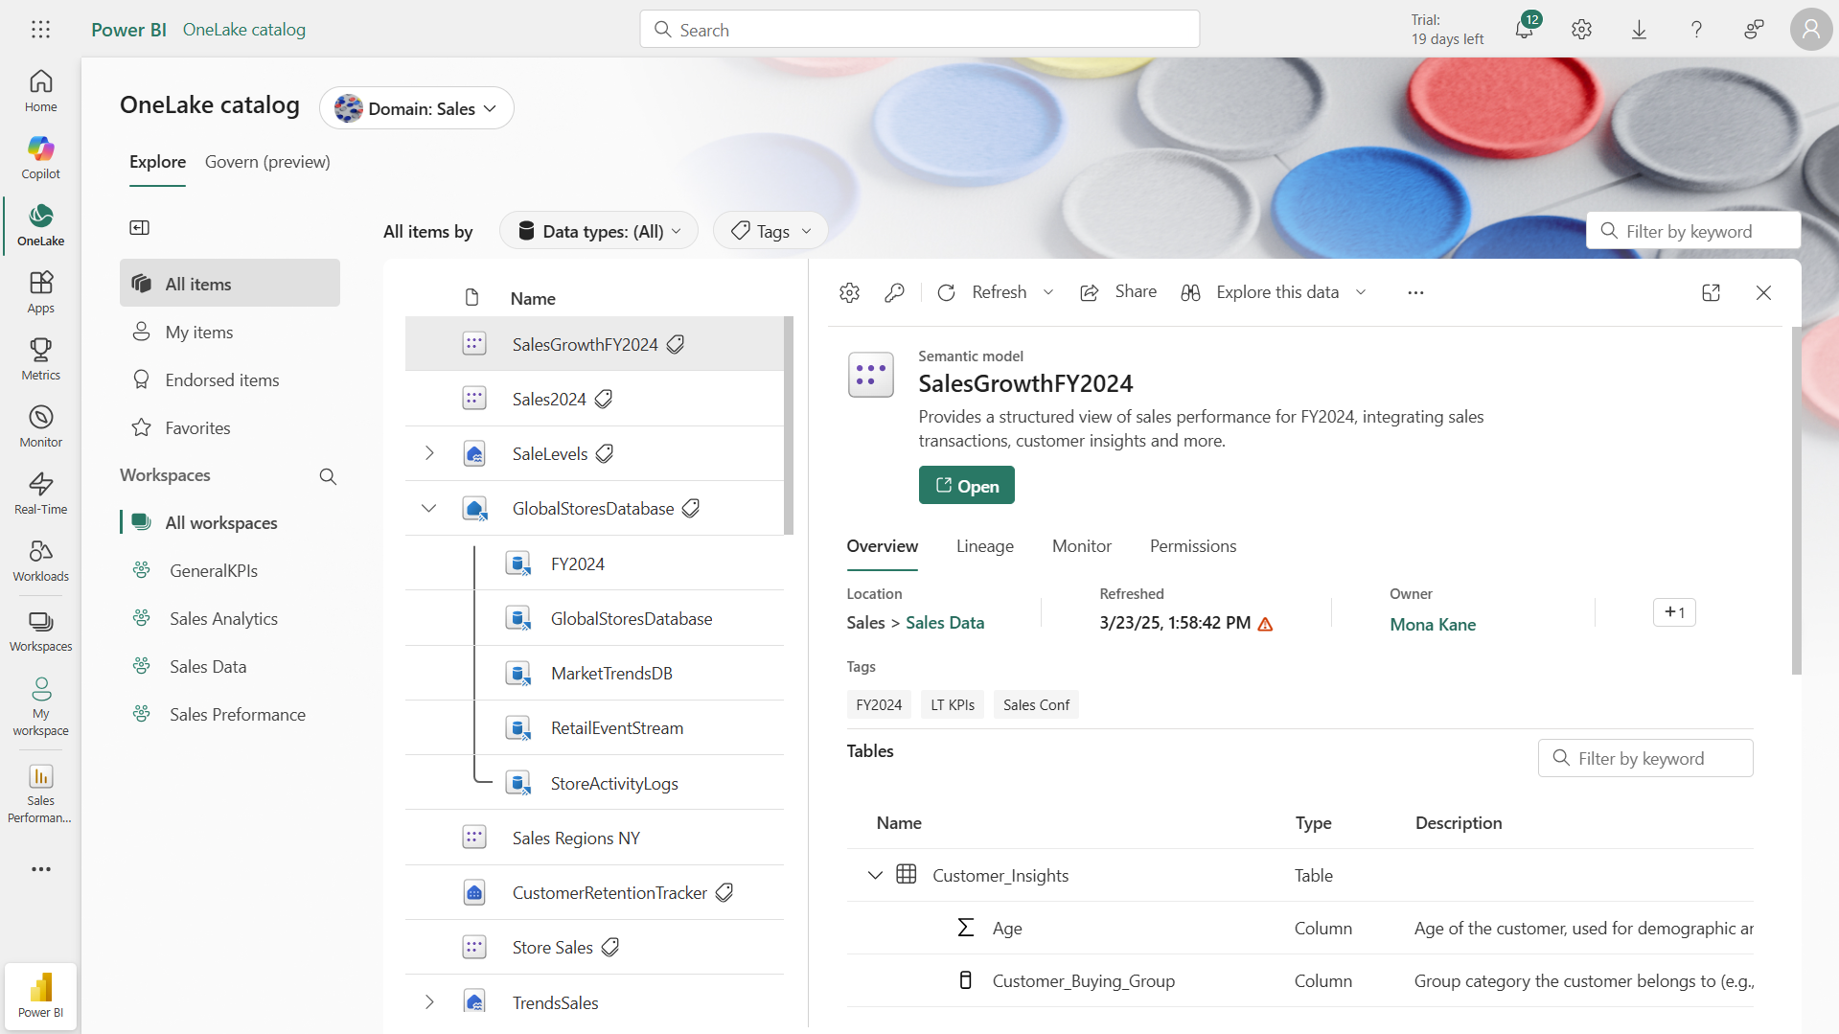
Explore your data w/ OneLake catalog
Complete catalog for data discovery, governance & insights in Fabric
Unified view of org data estate to boost discovery & collaboration across item types
Easily explore & manage your data centrally incl’ lineage, metadata, sensitivity, permissions
OLC everywhere: Integrated into MS365 – Teams & Excel (Insiders Fast), MS Copilot Studio, Azure Portal.
Coming next:
Curate your data with Copilot for auto-description & auto-summary.
Explore your data with Copilot to efficiently get insights from your data.
Roadmap: OneLake catalog Public APIs.

Slide 49
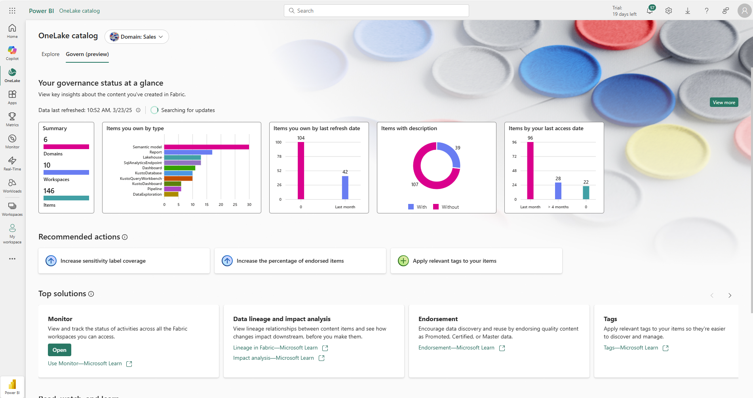
Govern your data w/ OneLake catalog
Complete catalog for data discovery, governance & insights in Fabric
Govern & gain insights on your data incl’ your item inventory, refresh, item curation, MIP labels.
Get Recommended actions, with information about the problem and instructions how to fix it
Find all the Tools , solutions and links available for you in Fabric
Coming next :
Additional Insights [external shares, permissions,..]
From Insights into immediate action
Roadmap: Extend Govern for tenant Admins

Slide 50

OneLake security

Slide 51






One Copy, many security definitions
Enabling fine-grained security at each engine
Each engine in Fabric provides its own robust set of security capabilities.
Data
Factory
Synapse Data
Engineering
Synapse Data
Science
Synapse Data Warehouse
Real-Time Intelligence
Power BI
Partner
Workloads
Serverless
Compute
OneLake also brings data lake security, applicable to engines like Spark.
Spark
T-SQL
KQL
Analysis Services
Pass to OneLake
Each Fabric engine relies on one of two modes when reading data from OneLake.
Customers 360
Finance
OneLake
Service Telemetry
Business KPIs
Delta – Parquet Format
Delta – Parquet Format
Delta – Parquet Format
Delta – Parquet Format

Slide 52
One Copy, One Security Definition
A single place to define and manage security
OneLake now has a complete set of fine-grained security features:
Table/folder security
Column level security
Row level security
+ more coming soon…
Data
Factory
Synapse Data
Engineering
Synapse Data
Science
Synapse Data Warehouse
Real-Time Intelligence
Power BI
Partner
Workloads
Serverless
Compute
Spark
T-SQL
KQL
Analysis Services
Engines can then switch to using passthrough mode as the primary security model.
Customers 360
Finance
OneLake
Service Telemetry
Business KPIs
Security is now centrally defined and enforced consistently across all engines.
Delta – Parquet Format
Delta – Parquet Format
Delta – Parquet Format
Delta – Parquet Format

Slide 53

Sign up for OneLake security preview

Slide 54


Manage, govern, and secure data in era of AI
Go further by integrating Fabric with Microsoft Purview
Microsoft Fabric
Microsoft Purview
Manage, govern, and secure your data locally in Microsoft Fabric with built-in capabilities
Employ advanced and global governance and security, including Microsoft Fabric
Local governance
Simplified administration
Global governance
Notes:
in an age of AI data security and governance takes an even more critical, central and important role, and when it comes to security it is a fundamentally team sport, and this is why we also natively integrate with Microsoft Purview, Microsoft’s data security and governance platform to provide you with advanced and data estate-wide security and governance capabilities. Over the past few years, organizations have seen a massive increase in their digital footprint, leading to data fragmentation, growth, and blind spots across their data estate. To help you tackle this mess, Microsoft Fabric, our end-to-end data platform, comes with built-in capabilities governance and security to help you effectively manage and govern your data. Fabric has built-in, industry-leading network and data security along with tools to help you manage federated data governance.
But since we know Fabric isn’t the only solution in your data estate, we also natively integrate with Microsoft’s data security and governance platform, Purview for your advanced and data estate-wide security and governance capabilities. You can manage Fabric’s data alongside everything else in your data estate.

Slide 55
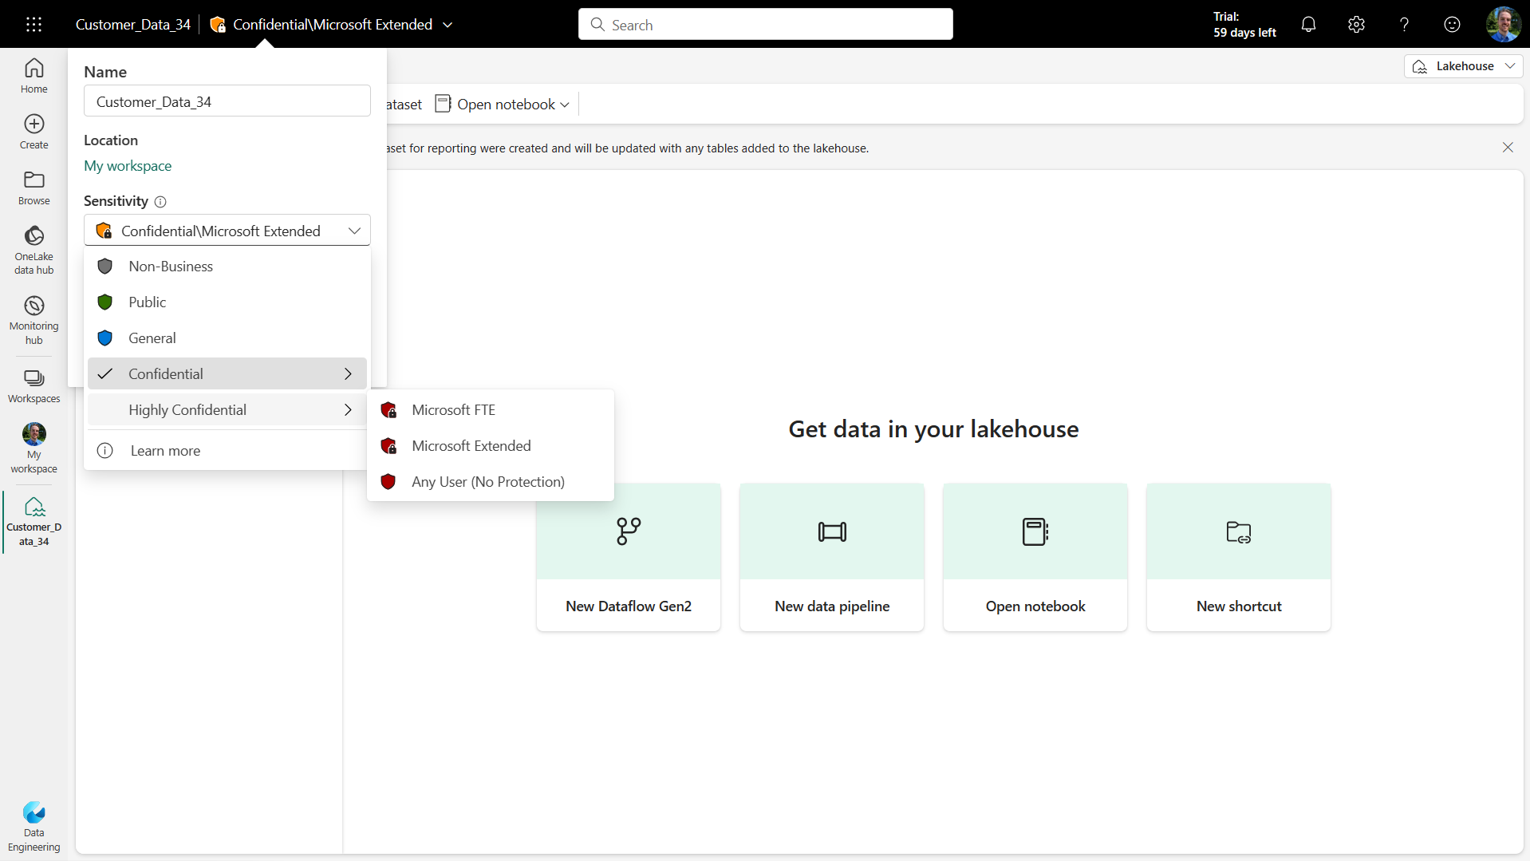
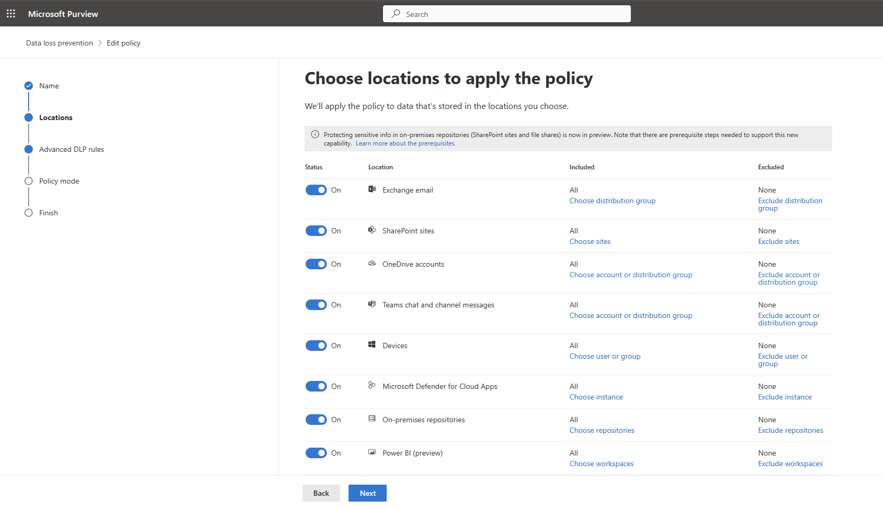
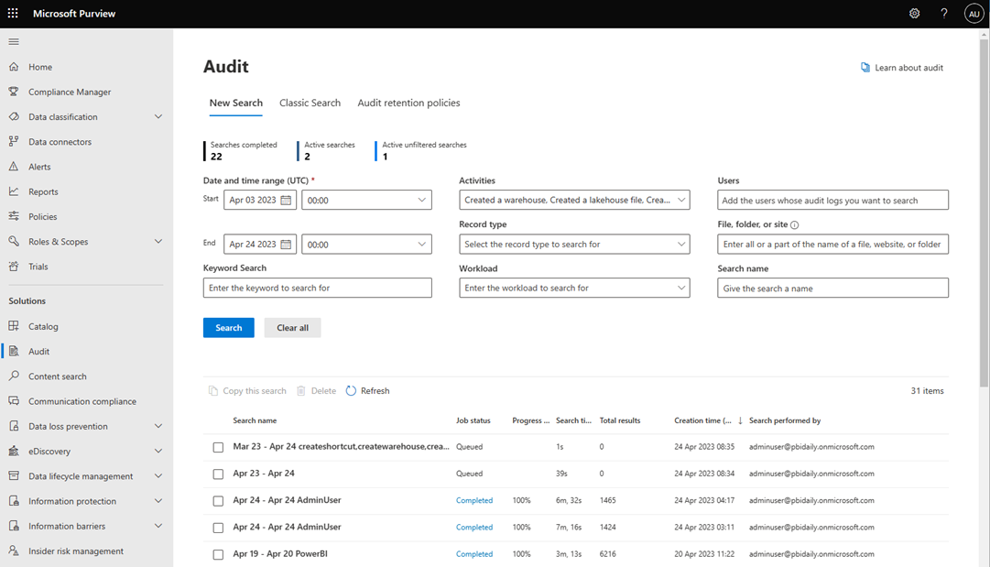
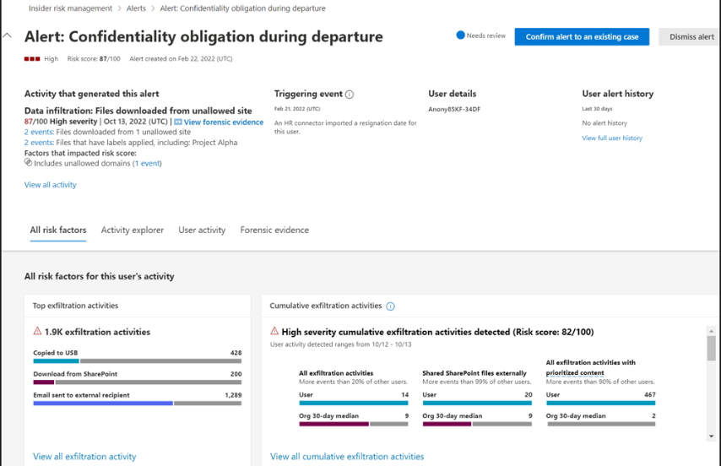
Purview Data Security & Compliance integration with Fabric
Information protection sensitivity labels and protection policies
Data loss prevention policies
Insider Risk Management
Audit
Classify sensitive Fabric data using the same sensitivity labels that are used in Microsoft 365—the label and protection travels with the data within Fabric, and enforced even when the data is exported to Office.
Automatically detect sensitive data such as PII or SSN in
Lakehouse or Semantic Models and trigger automatic risk remediation actions such as alerts or restrict access.
Log user activities from Microsoft Fabric in MS Purview Audit to support security, forensic, and internal investigations.
Ingest audit logs from Fabric in addition to other millions of signals to identify potential malicious or inadvertent insider risk.
Additional Microsoft Purview purchase required
Notes:
Beyond the security in Fabric, we’ve also created tight integration with the advanced security and compliance offerings of Microsoft Purview to help customers seamlessly secure data across their data estate. In Fabric, you can manually apply Purview Information Protection sensitivity labels to classify sensitive Fabric data—a familiar concept to the millions of Microsoft 365 users who employ these labels every day. You can also define Purview Information Protection policies in Microsoft Fabric to automatically enforce access permissions to sensitive information in Fabric.
We’ve also extended Purview Data Loss Prevention (DLP) policies to Fabric, enabling security teams to automatically identify the upload of sensitive information to Fabric, trigger automatic risk remediation actions, and restrict access to the data.
We’ve also simplified audits by automatically capturing user and system operations in Microsoft Purview audit logs. And finally, we’ve integrated with Purview Insider Risk Management to help customers detect, investigate, and act on malicious and inadvertent data oversharing activities in their organization.
*******************************************************************************************************************************************
With Purview security, Fabric users can set sensitivity label on their items and the beautiful thing here is that the same labels can be applied on all Microsoft 365 and other 1st party data sources like Azure SQL DB. And even better, the labels are inherited within Fabric from the source to the destination based on the lineage relations and the label is also inherited when it is exported to Excel file.
Moving on to DLP policies, based on security admin configuration, we can automatically detect sensitive info types in your data and recommend on remediation actions as they were setup by the security admin.
We also have Insider Risk Management in Purview, it gets all the audit logs From Fabric and activities from many other services and applications to identify potential insider risk such as data leakage and security violoations.

Slide 56

Any questions left?
Feedback

Slide 57
Let’s connect
Thank you
Erwin de Kreuk
Principal Consultant
Lead Data & AI InSpark
@erwindekreuk.bsky.social linkedin.com/in/erwindekreuk
erwindekreuk.com
github.com/edkreuk
https://sessionize.com/erwin-de-kreuk/
Dutchfabricusergroup.com
Notes:
We help organizations accelerating their digital transformation with impactful Microsoft solutions & expertise

